Slide 1
Dag 2 - RECAP fra Dag 1
Vi varmer op til dagens arbejde ved at repetere gårsdagens gennemgang

Slide 2
Hvad er IT Service management (ITSM)
IT Service management (ITSM) er styring af ressourcer, funktioner, roller, processer og viden, som gør det muligt for en servicevirksomhed at levere optimale it-services til deres kunder.

Slide 3
Service - Kendetegn
Årsagen til, at en kunde eller en forbruger ønsker at få en bestemt service, er, at denne har et behov for et bestemt resultat eller udbytte/profit.

Slide 4
Service Management
Ved Service Management forstås, de forhold, der sætter en serviceudbyder i stand til at levere services (ydelser).
Service
Er et middel til at tilføre en kunde værdi (i form af service), ved at bibringe (give) kunden det ønskede resultater, uden at kunden skal påtage sig de specifikke omkostninger og risici.
Service Management
Er et sæt specialiserede organisatoriske capabilities (kapaciteter), som tilfører værdi til kunder i form af services.

Slide 5
Ressourcer og Kapaciteter
En serviceudbyder har behov for (service-aktiver i form af) ressourcer og kapaciteter, for at skabe værdi (tilføre værdi til forbrugere/kunder) i form af services
Ressourcer
Indgår direkte i produktionen
Kapaciteter
Omdanner ressourcer til værdifulde services
En væsentlig forskel på ressourcer og kapaciteter er, at kapaciteter Kræver typisk væsentlig længere tid at fremskaffe end ressourcer.

Slide 6
Serviceværdi
Kunder værdsætter en service, når de kan se en klar sammenhæng mellem servicen og den forretningsværdi, servicen tilfører.
Fra kundens synspunkt opstår værdien af en service i kombinationen af to elementer:
Formålstjenlighed (Service utility)
Ved formålstjenlighed forstås den funktionalitet, som stilles til rådighed i kraft af servicen set fra kundens perspektiv.
Anvendelighed (Service warranty).
Ved anvendelighed forstås det forhold, at servicen vil leve op til de aftalte krav om tilgængelighed, kapacitet og sikkerhed. Disse krav kan aftales i en formel aftale, som f.eks. en Service Level Agreement (SLA) eller kontrakt.

Slide 7
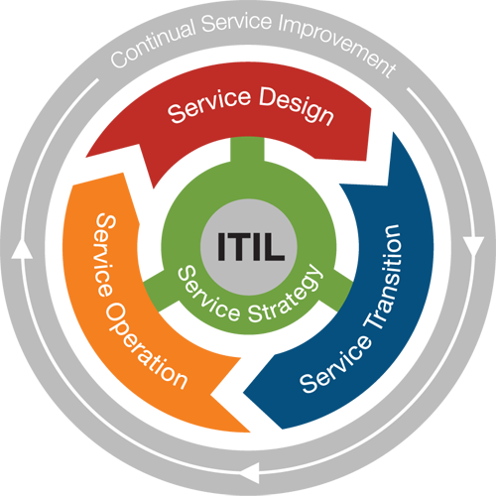
Best Practice – ”God skik”
ITIL Best Practice er sammensat af 5 grundlæggende hovedområder:
Service Strategy
Service Design
Service Transition
Service Operation
Continual Service Improvement
ITIL (Information Technology Infrastructure Library) er best practices for IT Service Management
ITIL beskriver processer, procedure, opgaver og tjeklister, som ikke er organisationsspecifikke.
ITIL kan anvendes af enhver organisation og giver muligheden for at planlægge, implementere og måle.

Slide 8
ITIL Modellen

Slide 9
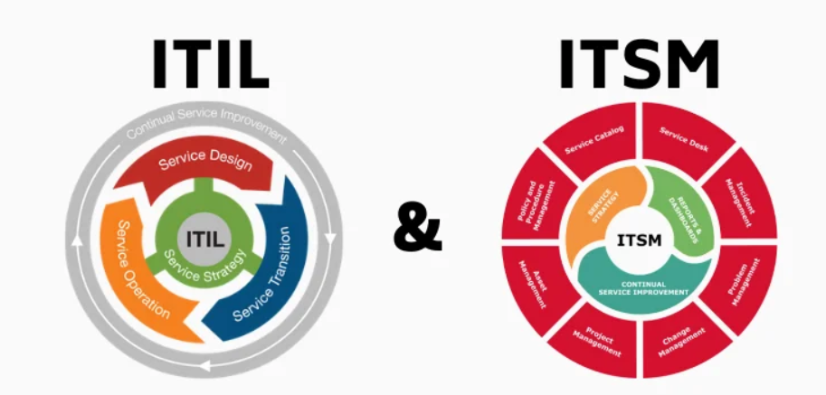
ITIL VS ITSM - MODELLEN

Slide 10
Information Technology Infrastructure Library (ITIL)
ITIL er en justerbar struktur, som beskriver bedste fremgangsmåder for at levere kvalitetsservice i informationsteknologi (IT) sektoren.
ITIL går ind i organisationsstrukturen, og de faglige færdigheder for en IT-organisation, ved at præsentere et udførligt sæt management-procedurer som en organisation kan benytte til at styre sine IT-operationer.
Disse procedurer er leverandøruafhængige og er relevante for alle aspekter af en IT infrastruktur.
ITIL er publiceret i en række bøger som hver dækker et emne. Navnene ITIL og IT Infrastructure Library er varemærker registreret af Office of Guvernement Commerce (OGC), som er en afdeling af den britiske regeringsadministration.
Emnerne i de enkelte bøger kaldes sets. På nuværende tidspunkt er der otte.
Sets er yderligere inddelt i discipliner, som hver især fokuserer på et specifikt emne.

Slide 11
Information Technology Infrastructure Library (ITIL)
De otte sets og deres discipliner er:
Service Delivery. Hvilke services skal datacenter yde for i tilpas omfang at understøtte forretningen.
Service Support. Hvorledes sikrer data center at kunden har adgang til passende services
Planning to Implement Service Management. Hvorledes startes processen med at skifte til ITIL. Den forklarer de nødvendige trin at tage for at undersøge hvorledes en organisation kan forvente gavn af ITIL
Security Management
ICT Infrastructure Management. Hvilke processer, organisering og værktøjer er nødvendige for at få en stabil IT og kommunikationsinfrastruktur. Dette er grundlaget for ITIL service management processerne.
The Business Perspective. Forklarer centrale principper og krav til forretningsorganisation og styring og hvorledes disse relaterer til udvikling, levering og support af IT service.
Application Management. Hvorledes man styrer softwareudvikling og software applikationers livsforløb.
Software Asset Management. Hvordan holder man styr på softwarelicenser i forhold til processer og CMDB.

Slide 12
Information Technology Infrastructure Library (ITIL)
ITIL service strategy - specifies that each stage of the service lifecycle must stay focused upon the business case, with defined business goals, requirements and service management principles.
ITIL service design - provides guidance for the production and maintenance of IT policies, architectures and documents.
ITIL service transition - focuses upon change management role and release practices, providing guidance and process activities for transitioning services into the business environment.
ITIL service operation - focuses upon delivery and control process activities based on a selection of service support and service delivery control points.
ITIL continual service improvement - focuses upon the process elements involved in identifying and introducing service management improvements, as well as issues surrounding service retirement.

Slide 13
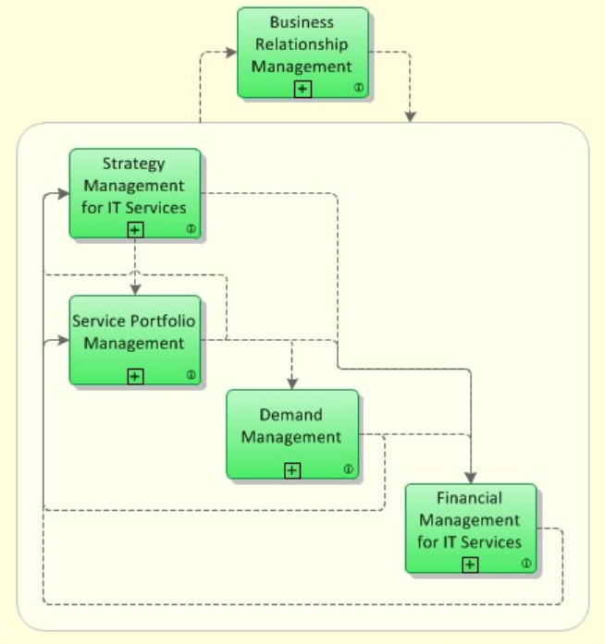
Service Strategy
Service Strategy provides a way how to design, develop and implement Service Management.
Service Strategy determines which types of services should be offered to which customers on which markets.
The following main processes are part of the ITIL Service Strategy lifecycle:
Strategy Management for IT Services
Process Objective: To assess the service provider's offerings, capabilities, competitors as well as current and potential market spaces in order to develop a strategy to serve customers. Once the strategy has been defined, Strategy Management for IT Services is also responsible for ensuring the implementation of the strategy.
Service Portfolio Management
Process Objective: Service Portfolio Management ensures that the service provider has the right mix of services to meet required business outcomes at an appropriate level of investment.
Financial Management for IT Services
Process Objective: To manage the service provider's budgeting, accounting and charging requirements.
Demand Management
Process Objective: To understand, anticipate and influence customer demand (efterspørgsel) for services.
Business Relationship Management
Process Objective: To maintain a positive relationship with customers.
To identify the needs of existing and potential customers and ensures that appropriate services are developed to meet those needs.

Slide 14
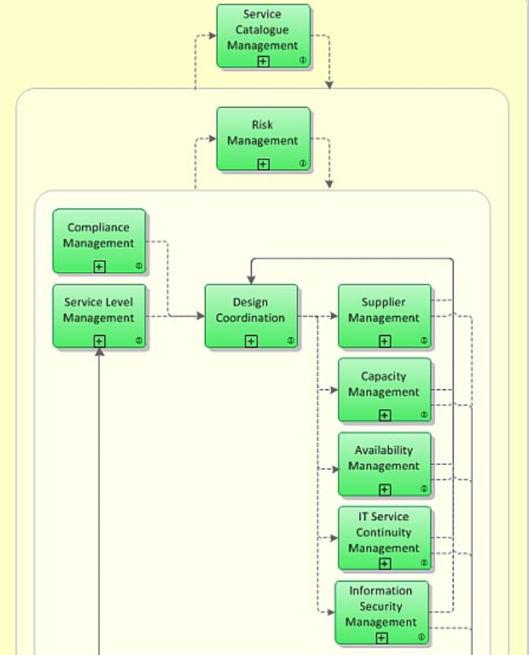

Service Design
The objective of ITIL Service Design is to design new IT services, as well as changes and improvements to existing IT-service.
Then it will be passed to Service Transition to be evaluated, built and tested, before deployed as a new or changed IT-service.
The following main processes are part of the Service Design lifecycle:
Design Coordination
Process Objective: To coordinate all service design activities, processes, tools and resources.
Ensure the effective design of new or changed IT services, architectures, technology and processes.
Service Catalogue Management
Process Objective: To ensure that a Service Catalogue is produced and maintained, containing information on all operational services
Service Level Management
Process Objective: To negotiate Service Level Agreements with the customers and to design services in accordance with the agreed service level targets.
Ensure that all suppliers meet their contractual commitments.
Ensure, the capacity of IT services and IT infrastructure is able to deliver the agreed service level targets in a cost effective and timely manner
Ensuring, all IT infrastructure, processes, tools, etc. are appropriate for the agreed availability services.
To manage risks that could seriously impact IT services
Ensure the confidentiality, integrity and availability of an organization's information, data and IT services.
Define a plan for the future development

Slide 15
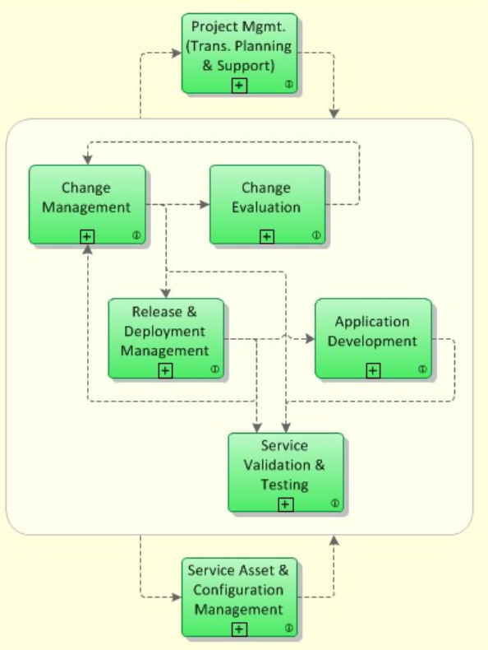
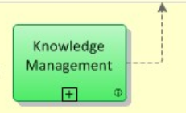
Service Transition
The Service Transition provides the development and improvement of new and changed services before transitioning into operations.
The following main processes are part of the ITIL stage Service Transition:
Change Management
Process Objective: To control the lifecycle of all Changes.
Is a process designed to minimize risks while making changes in IT infrastructure and with minimum disruption to IT services.
Change management also helps to minimize the impact of related incidents on service
Change Evaluation
Process Objective: To assess major Changes, like the introduction of a new service or a substantial change to an existing service, before those Changes are allowed to proceed to the next phase in their lifecycle.
Project Management (Transition Planning and Support)
Process Objective: To plan and coordinate the resources to deploy a major Release within the predicted cost, time and quality estimates.
Application Development
Process Objective: To make available applications and systems which provide the required functionality for IT services. This process includes the development and maintenance of custom applications as well as the customization of products from software vendors.

Slide 16
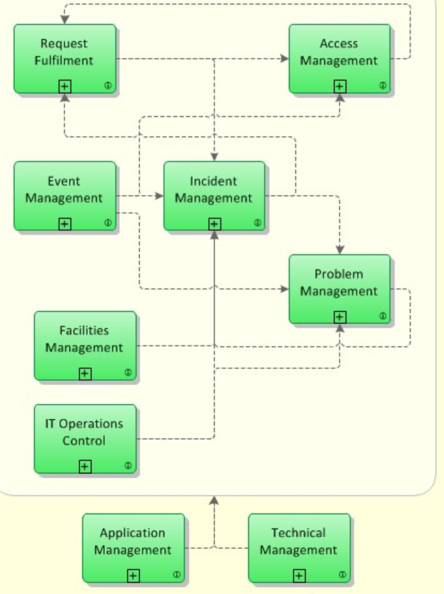
Service Operation Service Operation
The objective of ITIL Service Operation is to make sure that IT services are delivered effectively and efficiently.
The Service Operation lifecycle includes fulfilling of user requests, resolving incidents, resolving service failures, fixing problems, as well as carrying out routine operational tasks.
The following main processes are part of Service Operation lifecycle module:
Event Management
Process Objective: To make sure CIs and services are constantly monitored, and to filter and categorize Events in order to decide on appropriate actions.
Incident Management
Process Objective: To manage the lifecycle of all Incidents. The primary objective of Incident Management is to return the IT service to users as quickly as possible.
Request Fulfilment
Process Objective: To fulfill Service Requests, which in most cases are minor (standard) Changes (e.g. requests to change a password) or requests for information.
Request Fulfilment is the process for dealing with Service Requests – many of them actually smaller, lower-risk, changes – initially via the Service Desk.
• Oprettelse af brugere, • Password reset

Slide 17
Service Operation –Cont.
Incident management
Problem management
Slukker ildebrand
Sikrer der ikke opstår ildebrand
Retter fejl så incidents ikke opstår Eller retter flere incidents
Service genoprettelse

Slide 18
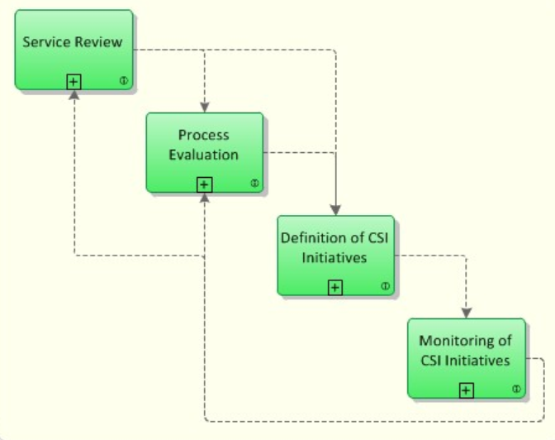
Continual Service Improvement
Er en slags ”vedligeholdelses og forbedringsfase”. Formålet her er, at man kigger på forbedringsmuligheder i samtlige faser.
Processen for Continual Service Improvement (CSI) bruger metoder fra kvalitetsstyring for at lære af tidligere succeser og fejl.
CSI forbedrer løbende effektiviteten af tjenester og processer.
Følgende hovedprocesser er en del af ITIL Continual Service Improvement (CSI):
Service Review
Procesmål: Formålet med denne proces er at forbedre servicekvaliteten, hvor det er nødvendigt, og at identificere mere økonomiske måder at yde en service på, hvor det er muligt.
Process Evaluation
Procesmål: At evaluere processer regelmæssigt. Dette omfatter identifikation af områder, hvor målretningsprocesserne ikke opnås.
Definition of CSI Initiatives
Procesmål: Definere specifikke initiativer med det formål at forbedre tjenester og processer, baseret på resultaterne af service reviews og procesevalueringer. De resulterende initiativer er enten interne initiativer, som udføres af tjenesteudbyderen på egne vegne eller initiativer, der kræver kundens samarbejde.
Monitoring of CSI Initiatives
Procesmål: For at kontrollere, om forbedringsinitiativerne foregår efter planen, og om nødvendigt indføre korrigerende foranstaltninger.

